Slide 1

Types of Charts

Slide 2
How do you know which chart to use?
In this PowerPoint, each chart will be defined and described with an example of the data it is most appropriately suited to represent.
How are charts used in other classes?
  Are charts used in Algebra? Why?
  Are charts used in Social Studies? Why?
  Are charts used in English? Why?

Slide 3
What you need to know
You need to know:
The six common charts used in business.
The object is to understand how each chart is used to communicate information.
  For example, if you are trying to compare the sales of Honda Civics to the sales of Nissan Altimas, what chart will best explain the data?
Why is one chart preferred over another?
Which chart will best communicate the data?

Slide 4
6 Common types of charts
Column Chart
Stacked Bar Chart
Line Chart
XY Scatter Chart
Pie Chart
Exploded Pie Chart

Slide 5
Column Chart
A Column Chart is used to make comparisons and generalizations about groups of data.
  such as, to compare the number of students from each class (Sophomores, Juniors, and Seniors) and their attendance and school spirit at assemblies.
A Column Chart is a series of vertical chart
columns, each representative of a data series.

Slide 6
Column Chart
This chart compares the attendance rates/school spirit of Seniors, Juniors, and Sophomores at assemblies over a period of four months.
School Spirit at Assemblies
Which group has the most consistent school spirit? The Sophomores have the most consistent attendance/school spirit, as evidenced by the green bars.
Notes:
Which group attends assemblies most consistently? – The sophomores have the most consistent attendance as evidenced by the green bars.
Which group attends the assemblies most inconsistently? The seniors. Their attendance increases in January and February, shows a dramatic increase in March, and declines by more than half in April.

Slide 7
Compare

Slide 8
Stacked Bar
This chart focuses more on each group’s contribution to the whole for any given month.

Slide 9
Line
This chart would be okay if we were analyzing trends in attendance rates, but it does not provide a good side-by-side comparison.

Slide 10
XY Scatter
This chart is trying to determine if there is a correlation between the month and the attendance rate.

Slide 11
Pie
Finally, this chart is useless for representing the data because it only allows for one data series.

Slide 12
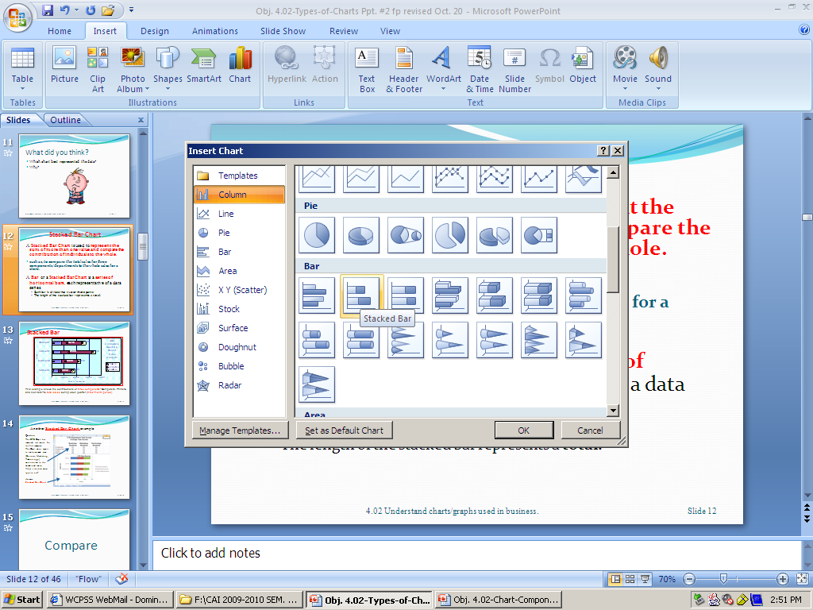
Stacked Bar Chart
A Stacked Bar Chart is used to represent the sum of more than one value and compare the contribution of individuals to the whole.
  such as, to compare the total sales for three components/departments to the whole sales for a store.
A Bar or a Stacked Bar Chart is a series of horizontal bars, each representative of a data series.
  Each bar is divided into two or more parts
  The length of the stacked bar represents a total.

Slide 13
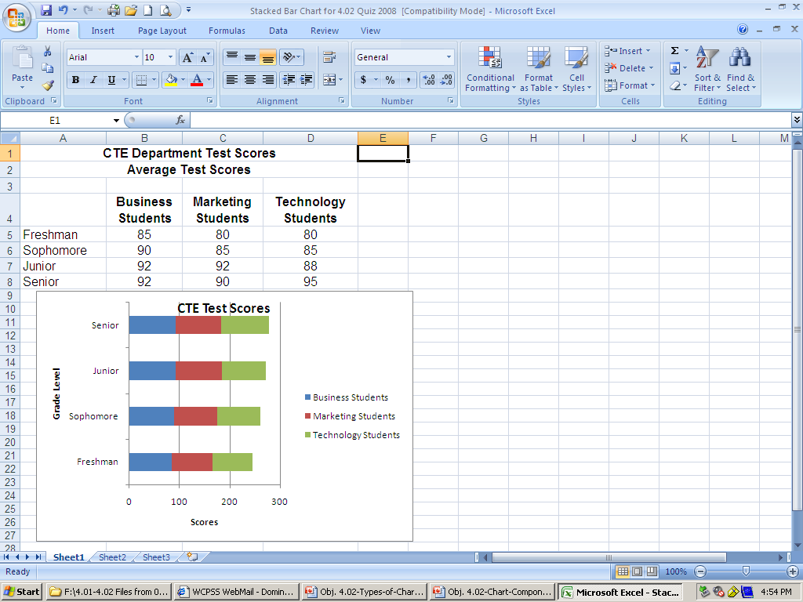
Another Stacked Bar Chart example:
Question:
The CTE Dept. has received test scores for the first semester.
The Dept. chair wants to see how each area (Business, Marketing, Technology) contributed to the combined score.
What is the best chart type to use?
Answer:
Stacked Bar Chart

Slide 14
Stacked Bar
This example shows the contributions of three components--Computers, Printers, and Monitors--to total sales during each quarter (three-month period).
Notes:
The components are displayed in the order presented in the spreadsheet.
What was the total sales for the first quarter? About $18,000
How much did printer sales contribute to the total sales for the first quarter? $5,000
How would you determine the percent of sales for printers to the total sales for the first quarter?

Slide 15
Compare

Slide 16
Column
This chart does not accurately represent the contributions of each part to the whole and is instead comparing them against each other.

Slide 17
Line
What about this chart? Can you clearly identify each component’s contribution to the whole?

Slide 18
XY Scatter
Why does this chart not work?

Slide 19
Pie
This chart only looks at one department.

Slide 20
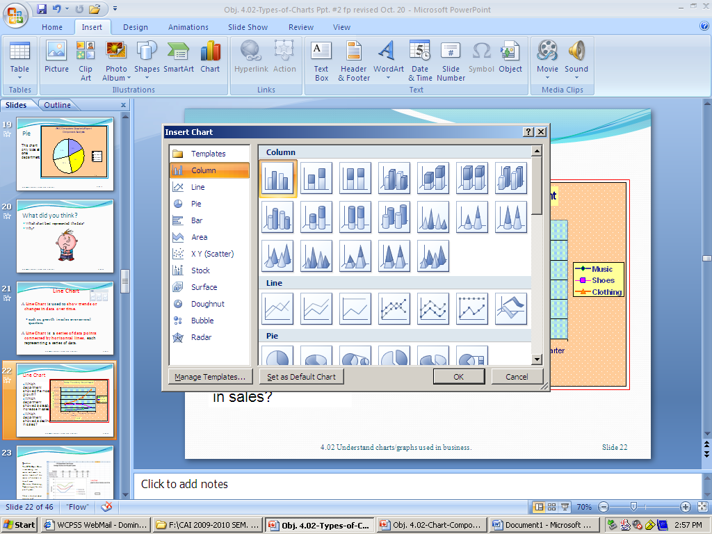
Line Chart
A Line Chart is used to show trends or changes in data over time.
  such as, growth in sales over several quarters.
A Line Chart is a series of data points connected by horizontal lines, each representing a series of data.

Slide 21
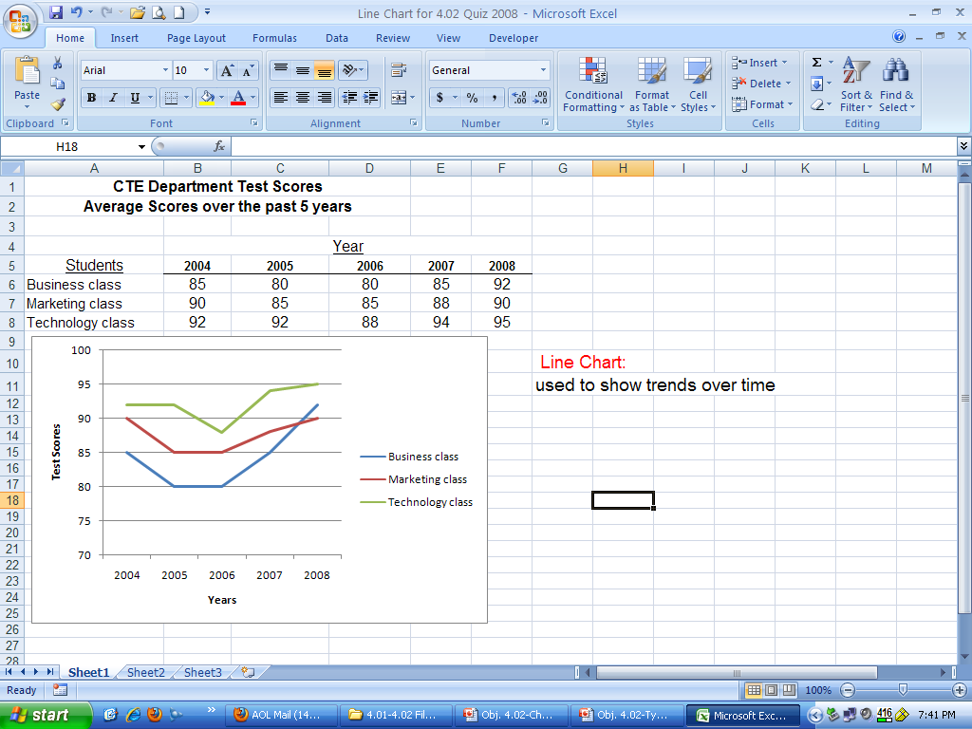
Another Line Chart example
Question:
The CTE Dept. Chair is reviewing test scores and wants to see the trends of the scores of students in these 3 areas (Business, Marketing, Technology) for the past 5 years.
What is the best chart type to use?
Answer:
Line Chart

Slide 22
Line Chart
Which department showed the most growth?
Which department showed a steady increase in sales?
Which department showed a decline in sales?

Slide 23
Compare

Slide 24
Column
To analyze the trends in this chart, the reader must read each data series separately and then make comparisons and generalizations.
However, in the previous Line Chart, trends were clearly and quickly analyzed just by looking at the lines.

Slide 25
Stacked Bar
Does this chart describe trends?

Slide 26
Pie
The pie chart fails to present all of the data.

Slide 27
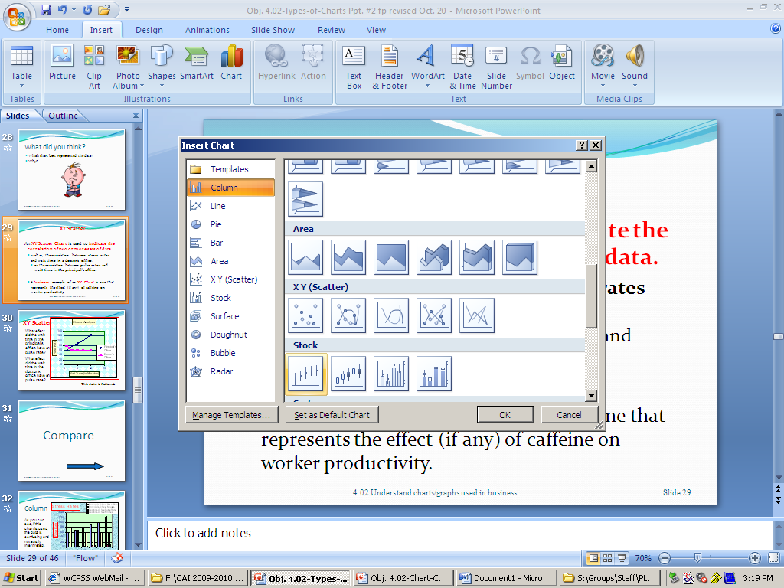
XY Scatter
An XY Scatter Chart is used to indicate the correlation of two or more sets of data.
    such as, the correlation between stress rates and wait time in a doctor’s office.
      or the correlation between pulse rates and
      wait time in the principal’s office.
    A business example of an XY Chart is one that represents the effect (if any) of caffeine on worker productivity.

Slide 28
XY Scatter
What effect did the wait time in the principal’s office have on pulse rate?
What effect did the wait time in the doctor’s office have on pulse rate?
This data is fictional.

Slide 29
Compare

Slide 30
Column
As you can see, if this chart is used, the data is confusing and not easily interpreted.

Slide 31
Stacked Bar
This chart is also hard to interpret.

Slide 32
Pie
The pie chart, once again, is clearly not the preferred chart for representing and communicating the data!

Slide 33
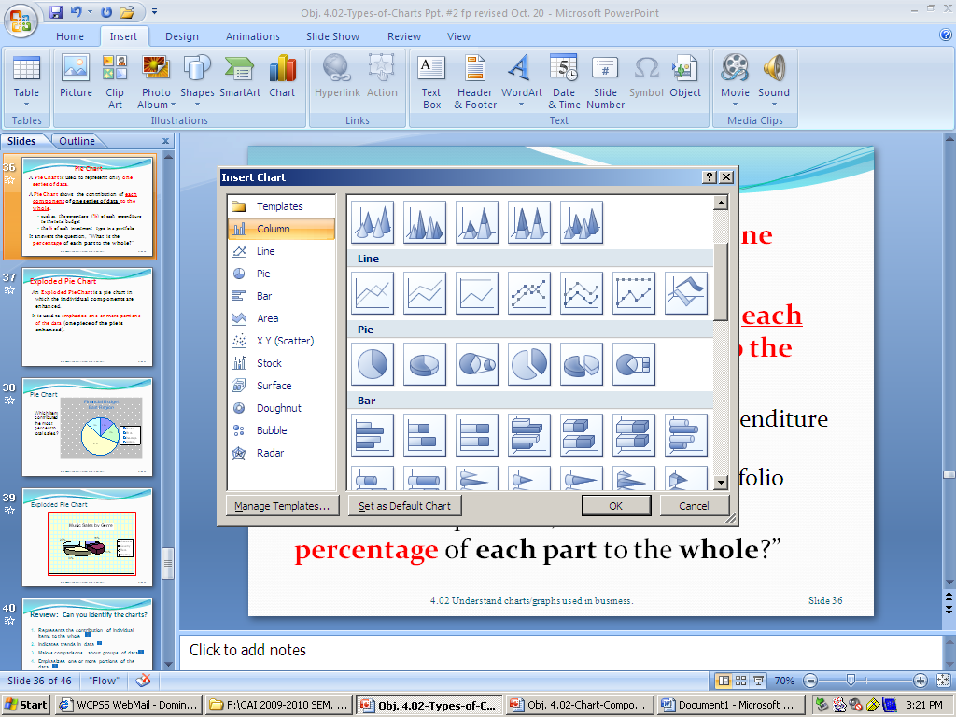
Pie Chart
A Pie Chart is used to represent only one series of data.
A Pie Chart shows the contribution of each component of one series of data to the whole.
        such as, the percentage (%) of each expenditure to the total budget
        the % of each investment type in a portfolio
It answers the question, “What is the percentage of each part to the whole?”

Slide 34
Pie Chart
Which item contributed the most percent to total sales?

Slide 35
Exploded Pie Chart
An Exploded Pie Chart is a pie chart in which the individual components are enhanced.
It is used to emphasize one or more portions of the data (one piece of the pie is enhanced).

Slide 36
Exploded Pie Chart

Slide 37
Review: Can you identify the charts?
Represents the contribution of individual items to the whole
Indicates trends in data
Makes comparisons about groups of data
Emphasizes one or more portions of the data
Represents only one series of data
Indicates a correlation
Notes:
Stacked bar
Line
Bar
Exploded pie
Pie
XY Scatter

Slide 38
Stacked Bar

Slide 39
XY Scatter

Slide 40
Column Chart

Slide 41
Exploded Pie

Slide 42
Pie

Slide 43
Line

